Slide 1
2013-14 Transportation Limitation Study
School Bus Transportation Eligibility for Students

Slide 2
Option One
Change To 2 & 3 Mile Limitations
* Any changes to transportation limits must be authorized by the school board and put up for a vote to the school district.
* Federal Guidelines allows school districts to require students to walk to school inside of these limits.
* Any student bused outside of these limits are aidable.
* Child Safety Zones can be utilized if they qualify under State Education Law Section 3635-b.
* Aid is available if CSZ are qualified.

Slide 3
Change of Transportation by grade
Two and Three mile limits
Grade Transported 2012 Change
Kindergarten All Two Miles
1st – 8th 7/10 of a Mile Two Miles
9th – 12th One Mile Three Miles
Special Needs All No Change
Private Schools All No Change
2012-13 our district transported students to seventeen different schools.
2011-12 we transported students to twenty different schools.
If a Private School student lives within the designated mileage for their grade they would be required to walk to Edison or Cohen and we would transport from there.

Slide 4
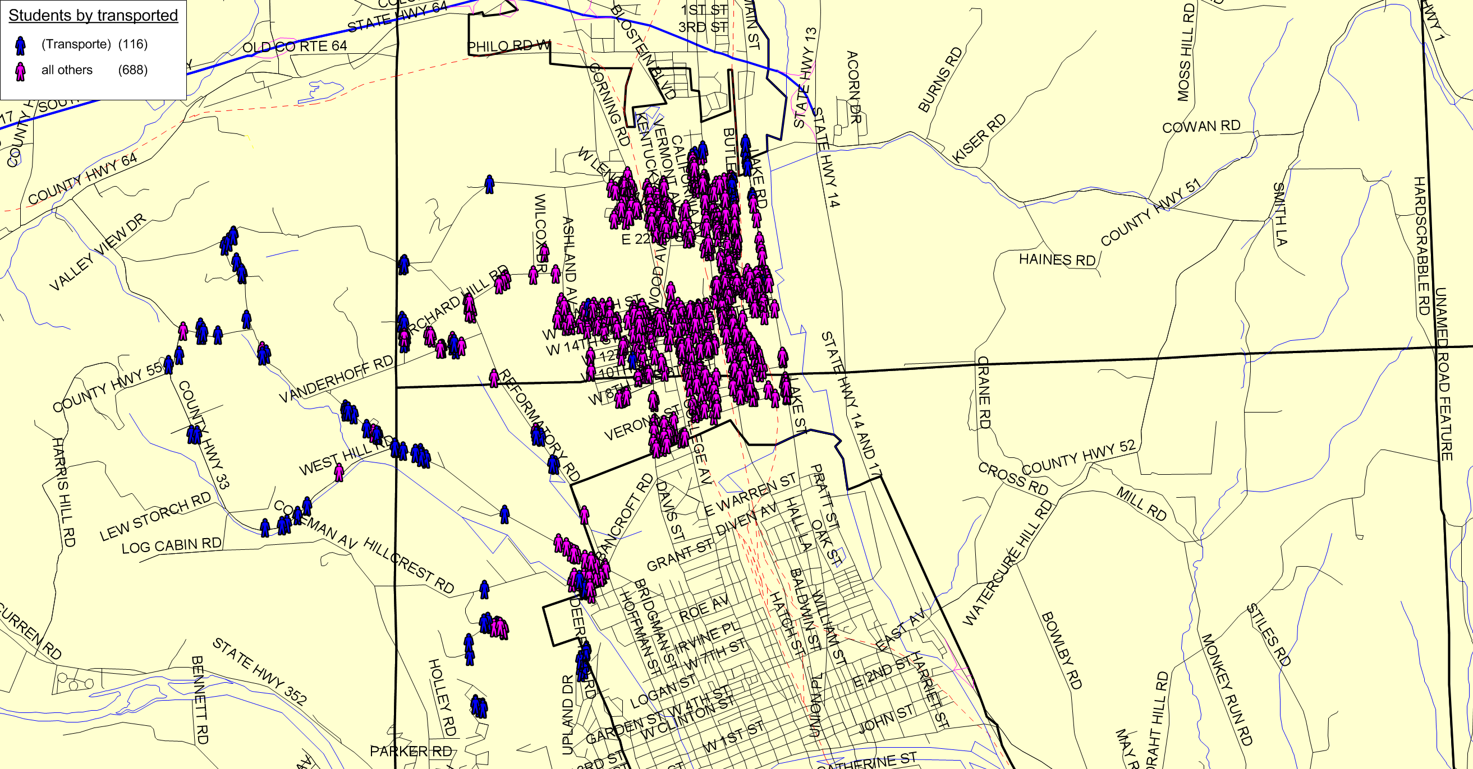

Slide 5
Outcome Under State Limitations would require:
85% of all students would lose transportation (including Kindergarten)
Traffic congestion would need to be expected and solutions explored
Approximately six bus runs and drivers could be eliminated
The purchasing of new buses will be eliminated and disbursement of bus assets would be explored
We must identify areas of concern for transporting students and create any CSZ that qualify.
Walking under-passes on 14th Street and 11Th Street must be utilized.

Slide 6
Child safety zones
Defined as a designated area within a common, central, central high school or union free school district, including at least one personal residence, within which children who reside at a lesser distance from school than the minimum eligibility distance may be provided transportation on the basis that their most direct walking route to school will traverse a hazardous zone. Once properly authorized by the board of education or trustees and the voters of the school district, such transportation may be provided for pupils in kindergarten through grade eight who reside within two mile of the school legally attended and for pupils in grades nine through twelve who reside within three miles of the school legally attended without regard to like circumstances.
Criteria: A district is either petitioned or the board may conduct their own investigation on its own initiative.
CSZ is Discretionary. Boards of Education are not required to provide transportation in child safety zones; it is completely discretionary for any school district to do so. State Education Law Section 3635-b

Slide 7
Criteria To Establish Child Safety Zones
Based on a point system for various safety hazards specified in Part 191 of the Regulations of the Commissioner of Transportation we need to conduct a required investigation. The point system is based on these three hazards.
Highways Without Sidewalks or Adequate Shoulders.
Highway Intersections.
Highway-railroad grade crossings.
Identify Potential Child Safety Zones
Rilla Street & West Lenox Avenue.
Upper Oakwood Avenue
Lake Road
Grand Central Avenue north of McConnell Avenue
Railroad Tracks that cross McCanns Blvd.
NY State Education created a point system to qualify a CSZ
Grades K-8 12 points needed.
Grades 9-12 15 points needed.

Slide 8
Option Two: Change to One mile and 1.25 miles
Grade Transported 2012 Change
Kindergarten All One Mile
1st – 5th 7/10 of a Mile One Mile
6th – 12th 7/10 & One Mile 1.25 Miles
Special Needs All No Change
Private Schools All No Change
2012-13 our district transports students to seventeen different schools.
2011-12 we transported students to twenty different schools.
If a Private School student lives within the designated mileage for their grade they would be required to walk to Edison or Cohen and we would transport from there.

Slide 9
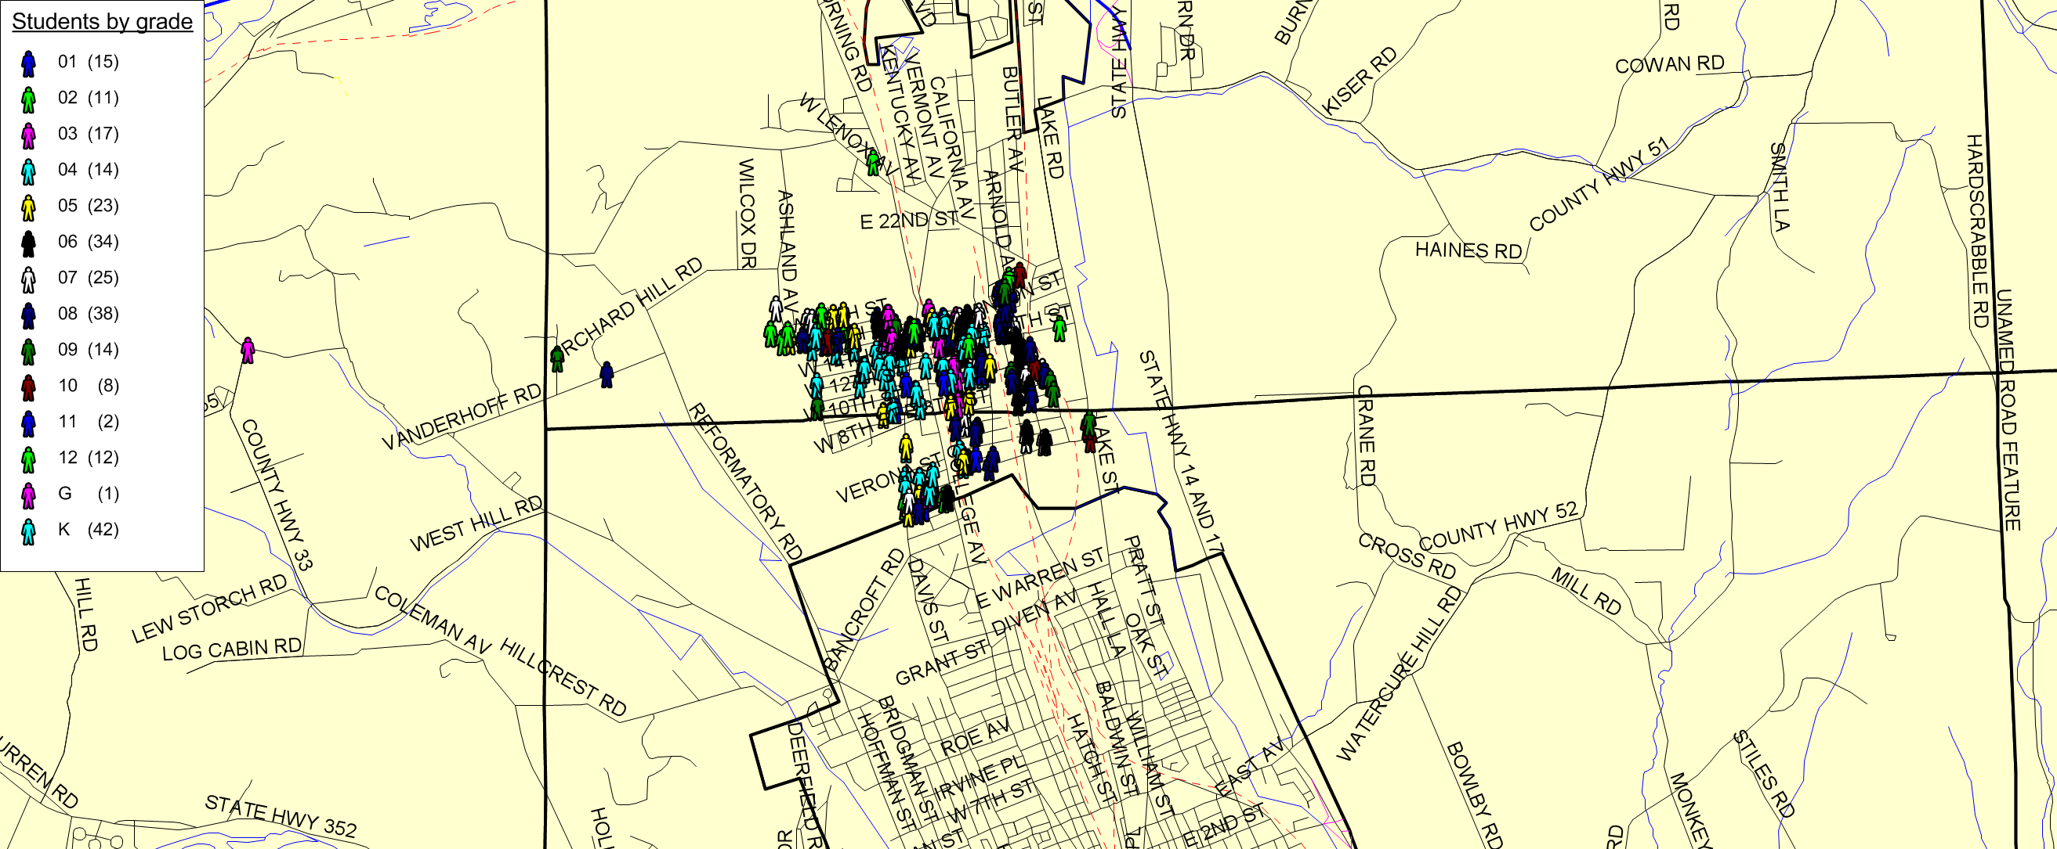
Option Two: Non-Eligible by grade
Approximately 256 students would no longer be eligible for transportation.

Slide 10
Rilla Avenue and West Lenox Avenue
4,160 feet of Shoulder < Five feet wide = 4,160’ / 500’ = 9 points
High Volume = more than 100 vehicles per 15 minutes = 5 points
40 MPH Zone = 1 point
Total Points = 15
Grades K – 8 12 points
Grades 9 – 12 15 points
All grades would qualify.
Upper Oakwood Would not qualify.
Lake Road Would not qualify.
Grand Central Ave. Would not qualify.
Railroad Tracks McCanns Blvd. Would not qualify.

Slide 11
Outcome for Option 2 would require:
31% of all students would lose transportation (including K)
Traffic congestion would need to be expected and solutions explored
Approximately three bus runs and drivers could be eliminated
The purchasing of new buses will be eliminated and disbursement of bus assets would be explored
We must identify areas of concern for transporting students and create any CSZ that qualify.
Walking under-passes on 14th Street and 11Th Street must be utilized.

Slide 12
Financial impact
Decrease in expenditures
      Salaries (drivers; no aides impacted as they are only provided on special needs buses)
      Fringe benefits (health insurance, retirement, FICA, workers compensation)
      Contractual expenses (contracted repairs, insurance)
      Material & supplies (fuel, repairs, etc)
  Decrease in Non-allowable pupil decimal
      The Non-allowable pupil decimal is based on the students that are transported that are not eligible for aid because they live less than the allowable state mileage limit and are not in Child Safety Zones (CSZ’s)
      Will result in receiving a greater percentage of aid
  Additional revenue from sale of buses, cameras and radios
      Must be sold over several years because aidable buses must be owned for 5 years before being sold

Slide 13
Financial impact continued…
As expenditures decrease, aid does not decrease proportionately because there is less “penalty” deducted for non-allowable pupils.
Sale of buses will continue as per original schedule
      Revenue from sales of buses will be received and deducted from aid
      Debt service will decrease because buses will not be replaced
      Corresponding aid on debt service will decrease as buses aren’t replaced
  Other considerations???
      Will we need a full-time mechanic (reduce FTE, functionally consolidate with Horseheads or another district)?
      Bus garage lease-This may be a fixed cost not dependent on the number of buses

Slide 14
Expenditures – current vs option 1
 |  | 2/3 Mile Limits
 | Projected | Projected
 | 2013-14 | 2013-14 | $ Increase | % Increase
Professional Salaries | 3,667 | 3,667 | - | 0.00%
Support Staff Salaries | 247,288 | 159,307 | (87,981) | -35.58%
Equipment | - | - | - | #DIV/0!
Contractual | 17,641 | 7,056 | (10,585) | -60.00%
Materials & Supplies | 77,035 | 44,020 | (33,015) | -42.86%
BOCES | 1,808 | 723 | (1,085) | -60.01%
Total Transportation Expenditures | 347,439 | 214,773 | (132,666) | -38.18%
Bus Garage Expenditures
Staff Salaries | 45,476 | 45,476 | - | 0.00%
Contractual | 2,341 | 2,341 | - | 0.00%
Materials & Supplies | 2,850 | 2,850 | - | 0.00%
Total Garage Expenditures | 50,667 | 50,667 | - | 0.00%
 |  |  | -
Contracted Transportation | 44,100 | 44,100 | - | 0.00%
 |  |  | -
Fringe Benefits | 341,976 | 258,891 | (83,085) | -24.30%
Debt Service on Buses | 265,406 | 265,406 | - | 0.00%
Bus Garage Lease | 20,620 | 20,620 | - | 0.00%
 |  |  | -
Total Transportation Expenditures | 1,070,208 | 854,457 | (215,751) | -20.16%
Notes:
Reduce by 6 drivers. Based on seniority reduces fringes by 3 family insurance policies, 1 buy-out & 2 retired employees. 2 retired employees salaries are not subject to district ERS contributions.

Slide 15
Revenue – current vs option 1
 |  | 2/3 Mile Limits
 | Projected | Projected
Transportation Revenue* | 2013-14 | 2013-14 | $ Increase | % Increase
Assumed Debt Service-Capital Expenditures | 252,136 | 252,136 | - | 0.00%
Deduct for Other Purpose Mileage | (31,517) | (31,517) | - | 0.00%
Deduct for Non-Allowable Students | (53,982) | - | 53,982 | -100.00%
Total Assumed Aidable Debt Service | 166,636 | 220,619 | 53,982 | 32.40%
Operating Expenditures | 566,497 | 350,746 | (215,751) | -38.09%
Deduct for Other Purpose Mileage | (70,812) | (43,843) | 26,969 | -38.09%
Deduct for Non-Allowable Students | (121,287) | - | 121,287 | -100.00%
Sale of Buses | (69,000) | (69,000) | - | 0.00%
Operating Expenditures Approved for Aid | 305,398 | 237,903 | (67,495) | -22.10%
Transportation Contracts | 42,000 | 42,000 | - | 0.00%
Deduct for Non-Allowable Students | (8,992) | - | 8,992 | -100.00%
Aidable Contract Expenses | 33,008 | 42,000 | 8,992 | 27.24%
Trans Suprvsrs Office Approved for Aid | 2,700 | 2,700 | - | 0.00%
Total Aidable Transportation Expenses | 507,742 | 503,222 | (4,520) | -0.89%
X Selected Transportation Aid Ratio | 0.9 | 0.9 | 0.9
Transportation Aid | 456,968 | 452,900 | (4,068) | -0.89%
* Aid is received in year following expenditures

Slide 16
Expenditures – current vs option 2
 |  | 1/1.25 Mile Limits
 | Projected | Projected
 | 2013-14 | 2013-14 | $ Increase | % Increase
Professional Salaries | 3,667 | 3,667 | - | 0.00%
Support Staff Salaries | 247,288 | 206,973 | (40,315) | -16.30%
Equipment | - | - | - | #DIV/0!
Contractual | 17,641 | 12,349 | (5,292) | -30.00%
Materials & Supplies | 77,035 | 77,035 | - | 0.00%
BOCES | 1,808 | 1,265 | (543) | -30.01%
Total Transportation Expenditures | 347,439 | 301,289 | (46,150) | -13.28%
Bus Garage Expenditures
Staff Salaries | 45,476 | 45,476 | - | 0.00%
Contractual | 2,341 | 2,341 | - | 0.00%
Materials & Supplies | 2,850 | 2,850 | - | 0.00%
Total Garage Expenditures | 50,667 | 50,667 | - | 0.00%
Contracted Transportation | 44,100 | 44,100 | - | 0.00%
Fringe Benefits | 341,976 | 298,962 | (43,015) | -12.58%
Debt Service on Buses | 265,406 | 265,406 | - | 0.00%
Bus Garage Lease | 20,620 | 20,620 | - | 0.00%
Total Transportation Expenditures | 1,070,208 | 981,044 | (89,165) | -8.33%
Notes:
Reduce by 3 drivers. Based on seniority reduces fringes by 2 family insurance policies, & 1 retired employees. 1 retired employee salary is not subject to district ERS contributions.

Slide 17
Revenues – current vs option 2
 |  | 1/1.25 Mile Limits
 | Projected | Projected
Transportation Revenue* | 2013-14 | 2013-14 | $ Increase | % Increase
Assumed Debt Service-Capital Expenditures | 252,136 | 252,136 | - | 0.00%
Deduct for Other Purpose Mileage | (31,517) | (31,517) | - | 0.00%
Deduct for Non-Allowable Students | (53,982) | (37,248) | 16,734 | -31.00%
Total Assumed Aidable Debt Service | 166,636 | 183,371 | 16,734 | 10.04%
Operating Expenditures | 566,497 | 477,333 | (89,165) | -15.74%
Deduct for Other Purpose Mileage | (70,812) | (59,667) | 11,146 | -15.74%
Deduct for Non-Allowable Students | (121,287) | (70,516) | 50,771 | -41.86%
Sale of Buses | (69,000) | (69,000) | - | 0.00%
Operating Expenditures Approved for Aid | 305,398 | 278,150 | (27,248) | -8.92%
Transportation Contracts | 42,000 | 42,000 | - | 0.00%
Deduct for Non-Allowable Students | (8,992) | (6,205) | 2,788 | -31.00%
Aidable Contract Expenses | 33,008 | 35,795 | 2,788 | 8.45%
Trans Suprvsrs Office Approved for Aid | 2,700 | 2,700 | - | 0.00%
Total Aidable Transportation Expenses | 507,742 | 500,017 | (7,726) | -1.52%
X Selected Transportation Aid Ratio | 0.9 | 0.9 | 0.9 | 100.00%
Transportation Aid | 456,968 | 450,015 | (6,953) | -1.52%
* Aid is received in year following expenditures

Slide 18
Summary expenditures and revenue
 | Current | 2/3 Mile Limits | 1/1.25 Mile Limits
 | Projected | Projected | Projected
 | 2013-14 | 2013-14 | 2013-14
Total Transportation Expenditures | 1,070,208 | 854,457 | 981,044
Transportation Aid | 456,968 | 452,900 | 450,015
Total Non-allowable Pupil Deduction | (184,262) | 0 | (113,968)

Slide 19
What limitation do other districts use?
Horseheads CSD All Students 1/8 mile
Elmira City School District K - 6th Grade 1 mile
7 & 8th Grade 1.5 miles
9 -12th Grade 2 miles
Spencer Van-Etten All Students ½ mile

Slide 20
Questions ????

